Slide 1
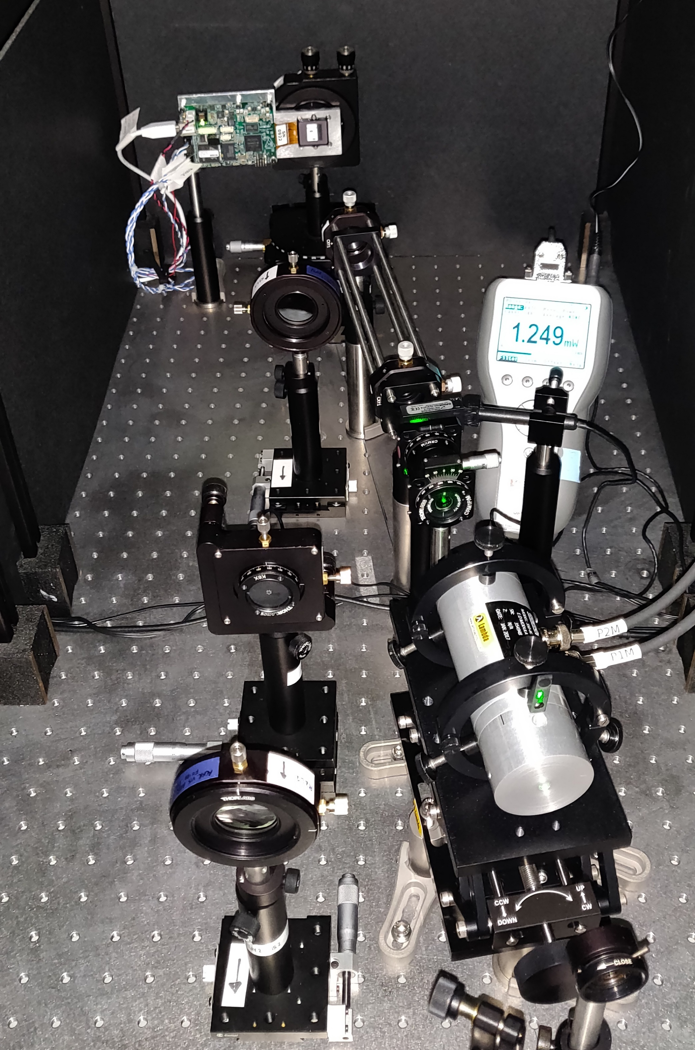
Spatial light modulator
Power meter
Linear polariser (for alignment only)
Quarter-wave plate
Spatial mask
To Pockels amplifier
Pockels cell
Built-in Glan-Taylor
polariser

